Slide 1

Tower of Hanoi
Prepared by :
Ridwan Mahfuz
ID:2411176144
Undergraduate student in Computer Science and Engineering
B.Sc. Engg. 2nd year 1st semester
University of Rajshahi

Slide 2
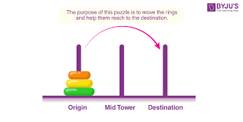



Introduction
The Tower of Hanoi is a classic mathematical puzzle that involves three Rods and a set of Disks of different sizes.
Rules:
1.Only one disk can be moved at a time.
2. A larger disk can never be placed on top of a smaller disk.
Goal: Move all disk from source to destination using helper.
1.Source 2.Helper 3.Destination

Slide 3
Analyzing the problem:
We can think about three cases:
If there was only one disk.
If there was two disks.
If there was three or more disks.

Slide 4
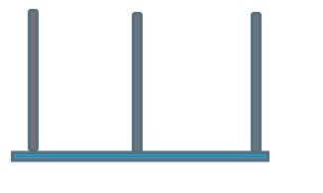
Case:1
1.Source 2.Helper 3.Destination
1.Source 2.Helper 3.Destination
1.Move S→D

Slide 5
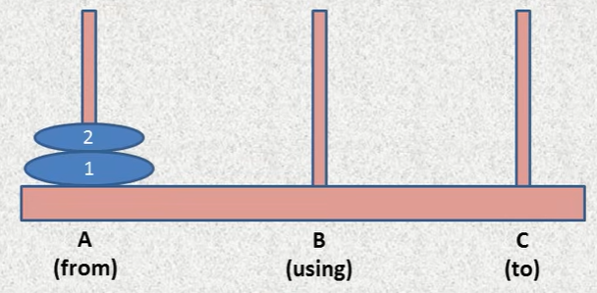
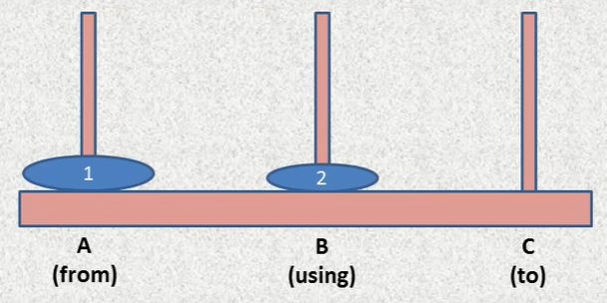
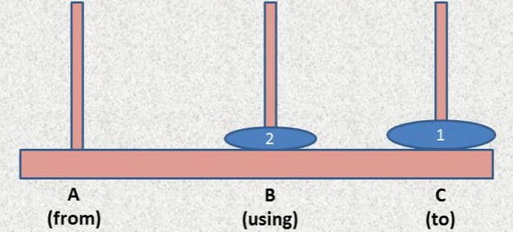

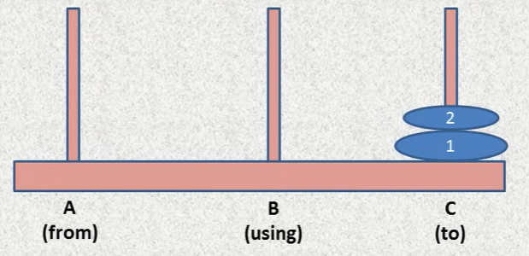
Case:2

Slide 6
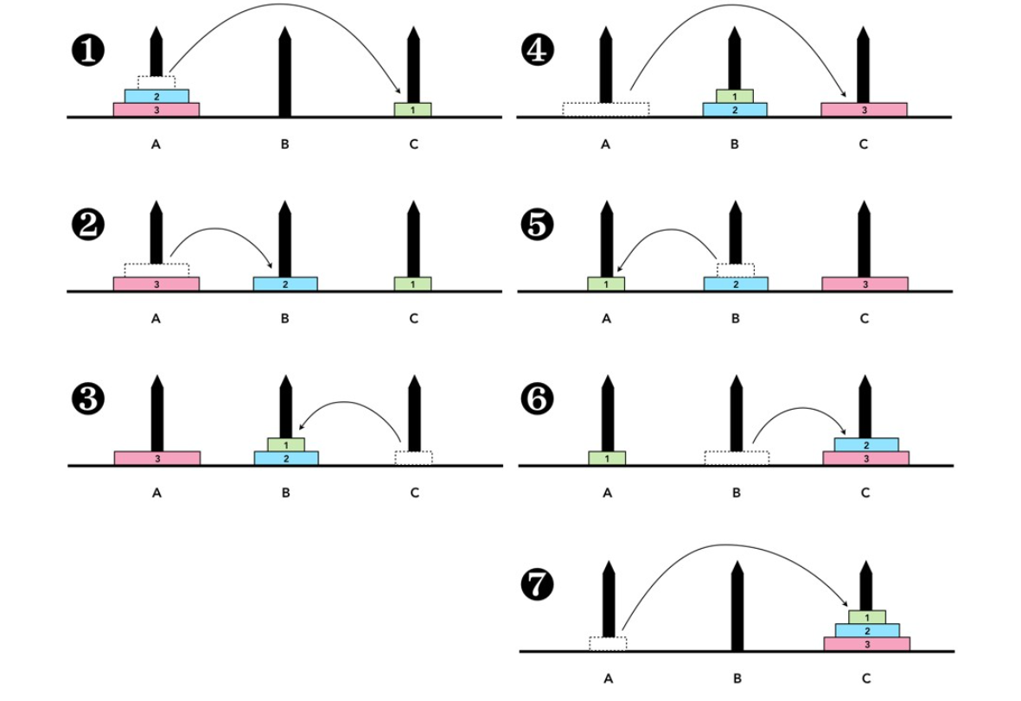
Case:3

Slide 7
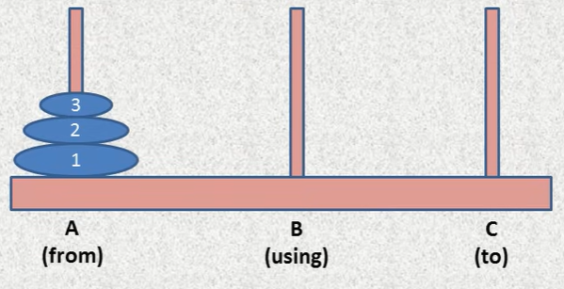
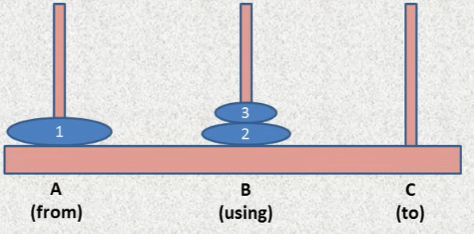
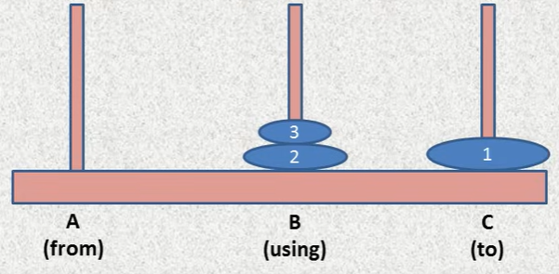
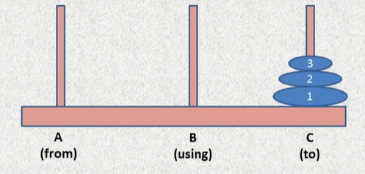
Case:3

Slide 8
Observation
To move n disks from S → D we can divide this problem in three subproblems:
1. Move n−1 disks from S → H (Source to Helper).
2. Move disk n from S → D (Source to Destination).
3. Move n−1 disks from H → D (Helper to Destination).

Slide 9
Recursive Algorithm
TOH(N,Source,Helper,Destination)
If N=1, then:
Print: S → D
Return.
Call TOH(N-1,Source,Destination,Helper)
(Move n−1 disks from S → H )
Print: S → D.
Call TOH(N-1,Source,Destination,Helper)
(Move n−1 disks from H → D )
Return.

Slide 10
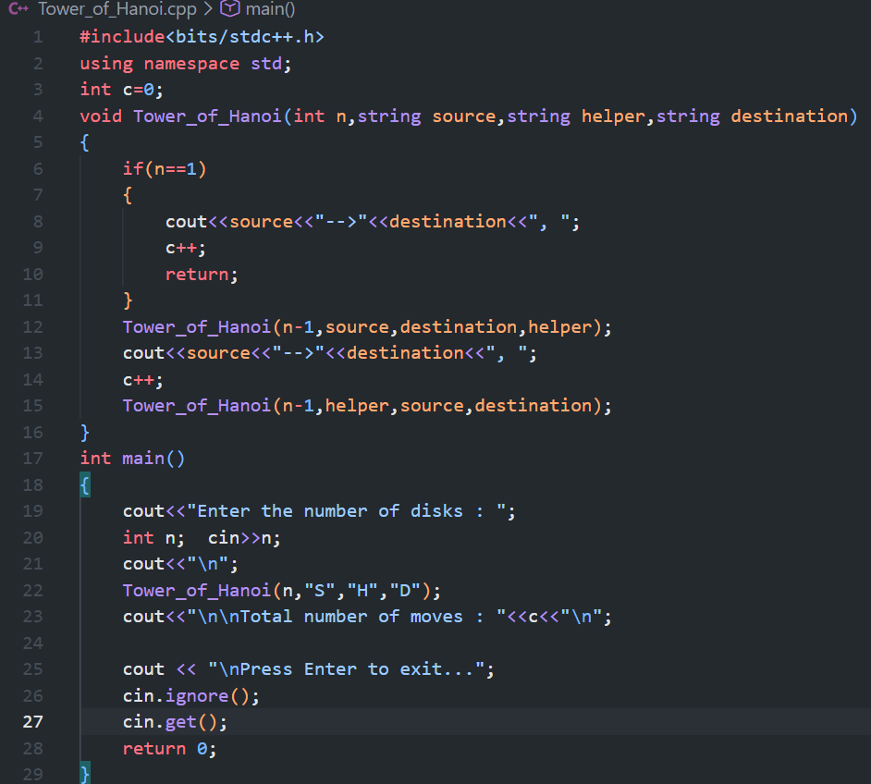
Implementation in c++
TOH(n, S, H, D):
if n == 1:
print S → D
else:
TOH(n-1, S, D, H)
print S → D
TOH(n-1, H, S , D)
Run
Play

Slide 11
What is happing Inside
N=3
TOH(3,S,H,D)
TOH(2,S,D,H)
S → D
TOH(2,H,S,D)
TOH(2,S,D,H)
TOH(1,S,H,D)
S → H
TOH(1,D,S,H)
TOH(2,H,S,D)
TOH(1,H,D,S)
H → D
TOH(1,S,H,D)
TOH(n, S, H, D):
if n == 1:
print S → D
else:
TOH(n-1, S, D, H)
print S → D
TOH(n-1, H, S , D)

Slide 12
What is happing Inside
N=3
TOH(3,S,H,D)
TOH(2,S,D,H)
S → D
TOH(2,H,S,D)
TOH(2,S,D,H)
TOH(1,S,H,D)
TOH(n, S, H, D):
if n == 1:
print S → D
else:
TOH(n-1, S, D, H)
print S → D
TOH(n-1, H, S , D)

Slide 13
What is happing Inside
N=3
TOH(3,S,H,D)
TOH(2,S,D,H)
S → D
TOH(2,H,S,D)
TOH(2,S,D,H)
TOH(1,S,H,D) > S → D (1)
TOH(n, S, H, D):
if n == 1:
print S → D
else:
TOH(n-1, S, D, H)
print S → D
TOH(n-1, H, S , D)

Slide 14
What is happing Inside
N=3
TOH(3,S,H,D)
TOH(2,S,D,H)
S → D
TOH(2,H,S,D)
TOH(2,S,D,H)
TOH(1,S,H,D) > S → D (1)
S → H
TOH(n, S, H, D):
if n == 1:
print S → D
else:
TOH(n-1, S, D, H)
print S → D
TOH(n-1, H, S , D)

Slide 15
What is happing Inside
N=3
TOH(3,S,H,D)
TOH(2,S,D,H)
S → D
TOH(2,H,S,D)
TOH(2,S,D,H)
TOH(1,S,H,D) > S → D (1)
S → H > S → H (2)
TOH(n, S, H, D):
if n == 1:
print S → D
else:
TOH(n-1, S, D, H)
print S → D
TOH(n-1, H, S , D)

Slide 16
What is happing Inside
N=3
TOH(3,S,H,D)
TOH(2,S,D,H)
S → D
TOH(2,H,S,D)
TOH(2,S,D,H)
TOH(1,S,H,D) > S → D (1)
S → H > S → H (2)
TOH(1,D,S,H)
TOH(n, S, H, D):
if n == 1:
print S → D
else:
TOH(n-1, S, D, H)
print S → D
TOH(n-1, H, S , D)

Slide 17
What is happing Inside
N=3
TOH(3,S,H,D)
TOH(2,S,D,H)
S → D
TOH(2,H,S,D)
TOH(2,S,D,H)
TOH(1,S,H,D) > S → D (1)
S → H > S → H (2)
TOH(1,D,S,H) > D → H (3)
TOH(n, S, H, D):
if n == 1:
print S → D
else:
TOH(n-1, S, D, H)
print S → D
TOH(n-1, H, S , D)

Slide 18
What is happing Inside
N=3
TOH(3,S,H,D)
TOH(2,S,D,H)
S → D
TOH(2,H,S,D)
TOH(2,S,D,H)
TOH(1,S,H,D) > S → D (1)
S → H > S → H (2)
TOH(1,D,S,H) > D → H (3)
TOH(n, S, H, D):
if n == 1:
print S → D
else:
TOH(n-1, S, D, H)
print S → D
TOH(n-1, H, S , D)

Slide 19
What is happing Inside
N=3
TOH(3,S,H,D)
TOH(2,S,D,H)
S → D
TOH(2,H,S,D)
TOH(2,S,D,H)
TOH(1,S,H,D) > S → D (1)
S → H > S → H (2)
TOH(1,D,S,H) > D → H (3)
TOH(n, S, H, D):
if n == 1:
print S → D
else:
TOH(n-1, S, D, H)
print S → D
TOH(n-1, H, S , D)
S → D (4)

Slide 20
What is happing Inside
N=3
TOH(3,S,H,D)
TOH(2,S,D,H)
S → D
TOH(2,H,S,D)
TOH(2,S,D,H)
TOH(1,S,H,D) > S → D (1)
S → H > S → H (2)
TOH(1,D,S,H) > D → H (3)
TOH(2,H,S,D)
TOH(n, S, H, D):
if n == 1:
print S → D
else:
TOH(n-1, S, D, H)
print S → D
TOH(n-1, H, S , D)
S → D (4)

Slide 21
What is happing Inside
N=3
TOH(3,S,H,D)
TOH(2,S,D,H)
S → D
TOH(2,H,S,D)
TOH(2,S,D,H)
TOH(1,S,H,D) > S → D (1)
S → H > S → H (2)
TOH(1,D,S,H) > D → H (3)
TOH(2,H,S,D)
TOH(1,H,D,S)
TOH(n, S, H, D):
if n == 1:
print S → D
else:
TOH(n-1, S, D, H)
print S → D
TOH(n-1, H, S , D)
S → D (4)

Slide 22
What is happing Inside
N=3
TOH(3,S,H,D)
TOH(2,S,D,H)
S → D
TOH(2,H,S,D)
TOH(2,S,D,H)
TOH(1,S,H,D) > S → D (1)
S → H > S → H (2)
TOH(1,D,S,H) > D → H (3)
TOH(2,H,S,D)
TOH(1,H,D,S) > H → S (5)
TOH(n, S, H, D):
if n == 1:
print S → D
else:
TOH(n-1, S, D, H)
print S → D
TOH(n-1, H, S , D)
S → D (4)

Slide 23
What is happing Inside
N=3
TOH(3,S,H,D)
TOH(2,S,D,H)
S → D
TOH(2,H,S,D)
TOH(2,S,D,H)
TOH(1,S,H,D) > S → D (1)
S → H > S → H (2)
TOH(1,D,S,H) > D → H (3)
TOH(2,H,S,D)
TOH(1,H,D,S) > H → S (5)
H → D
TOH(n, S, H, D):
if n == 1:
print S → D
else:
TOH(n-1, S, D, H)
print S → D
TOH(n-1, H, S , D)
S → D (4)

Slide 24
What is happing Inside
N=3
TOH(3,S,H,D)
TOH(2,S,D,H)
S → D
TOH(2,H,S,D)
TOH(2,S,D,H)
TOH(1,S,H,D) > S → D (1)
S → H > S → H (2)
TOH(1,D,S,H) > D → H (3)
TOH(2,H,S,D)
TOH(1,H,D,S) > H → S (5)
H → D > H → D (6)
TOH(n, S, H, D):
if n == 1:
print S → D
else:
TOH(n-1, S, D, H)
print S → D
TOH(n-1, H, S , D)
S → D (4)

Slide 25
What is happing Inside
N=3
TOH(3,S,H,D)
TOH(2,S,D,H)
S → D
TOH(2,H,S,D)
TOH(2,S,D,H)
TOH(1,S,H,D) > S → D (1)
S → H > S → H (2)
TOH(1,D,S,H) > D → H (3)
TOH(2,H,S,D)
TOH(1,H,D,S) > H → S (5)
H → D > H → D (6)
TOH(1,S,H,D)
TOH(n, S, H, D):
if n == 1:
print S → D
else:
TOH(n-1, S, D, H)
print S → D
TOH(n-1, H, S , D)
S → D (4)

Slide 26
What is happing Inside
N=3
TOH(3,S,H,D)
TOH(2,S,D,H)
S → D
TOH(2,H,S,D)
TOH(2,S,D,H)
TOH(1,S,H,D) > S → D (1)
S → H > S → H (2)
TOH(1,D,S,H) > D → H (3)
TOH(2,H,S,D)
TOH(1,H,D,S) > H → S (5)
H → D > H → D (6)
TOH(1,S,H,D) > S → D (7)
TOH(n, S, H, D):
if n == 1:
print S → D
else:
TOH(n-1, S, D, H)
print S → D
TOH(n-1, H, S , D)
S → D (4)

Slide 27
What is happing Inside
N=3
TOH(3,S,H,D)
TOH(2,S,D,H)
S → D
TOH(2,H,S,D)
TOH(2,S,D,H)
TOH(1,S,H,D) > S → D (1)
S → H > S → H (2)
TOH(1,D,S,H) > D → H (3)
TOH(2,H,S,D)
TOH(1,H,D,S) > H → S (5)
H → D > H → D (6)
TOH(1,S,H,D) > S → D (7)
TOH(n, S, H, D):
if n == 1:
print S → D
else:
TOH(n-1, S, D, H)
print S → D
TOH(n-1, H, S , D)
S → D (4)

Slide 28


What is happing Inside
N=3
TOH(3,S,H,D)
TOH(2,S,D,H)
S → D
TOH(2,H,S,D)
TOH(2,S,D,H)
TOH(1,S,H,D) > S → D (1)
S → H > S → H (2)
TOH(1,D,S,H) > D → H (3)
TOH(2,H,S,D)
TOH(1,H,D,S) > H → S (5)
H → D > H → D (6)
TOH(1,S,H,D) > S → D (7)
TOH(n, S, H, D):
if n == 1:
print S → D
else:
TOH(n-1, S, D, H)
print S → D
TOH(n-1, H, S , D)
S → D (1)
S → H (2)
D → H (3)
S → D (4)
H → S (5)
H → D (6)
S → D (7)
S → D (4)

Slide 29
Thank You For Being Patient

